Slide 1
CSE225 - Data Structures and Algorithms
Hash Tables and Blockchain
Mosroor Mofiz Arman
1921079642
Section: 4

Slide 2
Hash Tables
Maps keys to values using a hash function.
Consists of an array of buckets, where each bucket can store multiple key-value pairs.
Determines the index of the array where a particular key-value pair should be stored.

Slide 3
Characteristics
Fast Access
Hash Function
Collision Handling
Dynamic Sizing

Slide 4
Problems Addressed
Fast Lookup
Associative Arrays
Caching

Slide 5
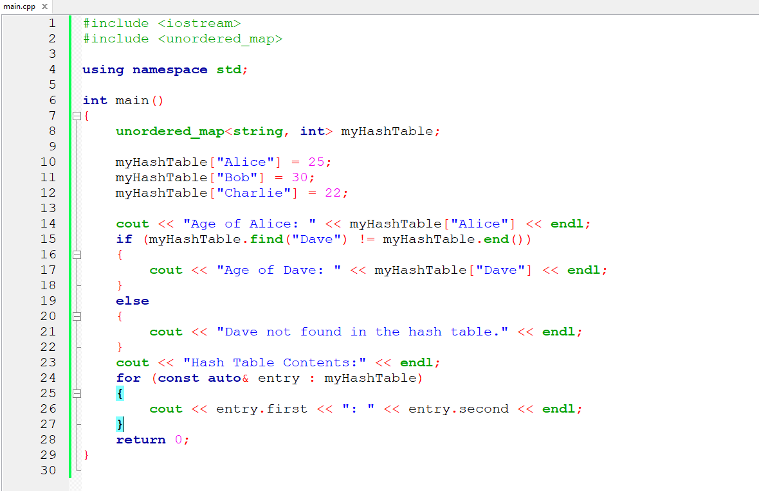
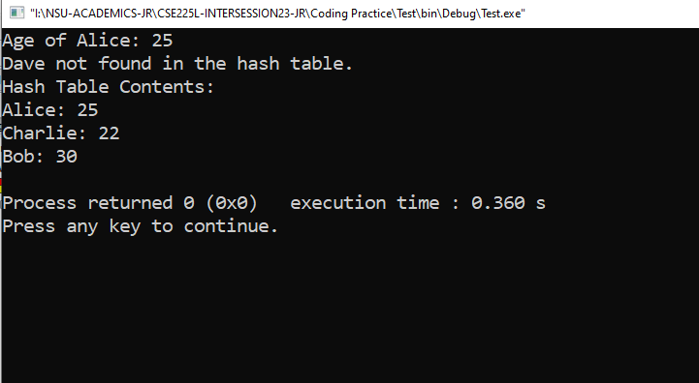
Implementation

Slide 6
Implementation Analysis
Open Addressing:
Advantages: Simplicity, Memory Efficiency, Cache Friendliness, Space Efficiency.
Pitfalls: Clustering, Probing Sequences, Difficulty in Deletion, Load Factor Sensitivity.
Chaining:
Advantages: Simple implementation, effective for handling collisions.
Pitfalls: Can lead to performance issues when the linked lists become too long.

Slide 7
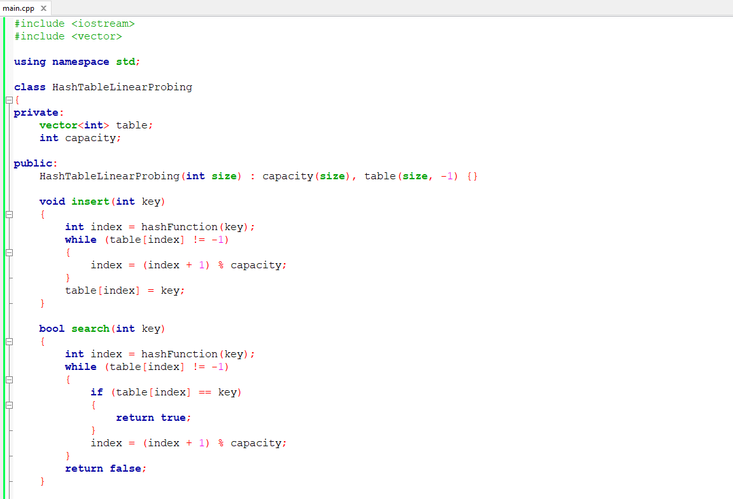
Open Addressing(Linear Probing)

Slide 8
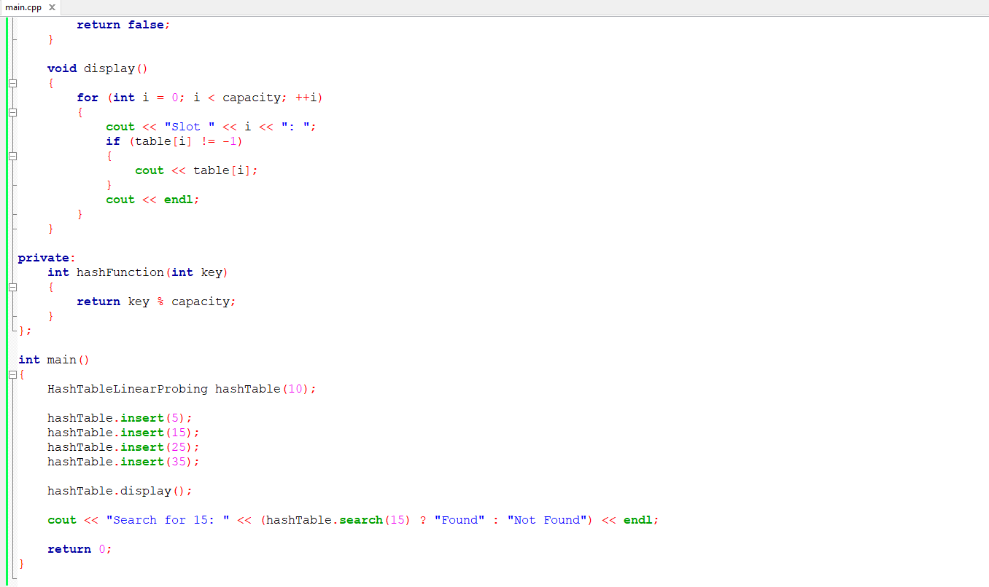
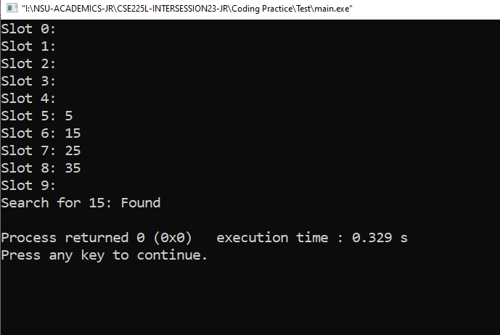
Open Addressing(Linear Probing)

Slide 9
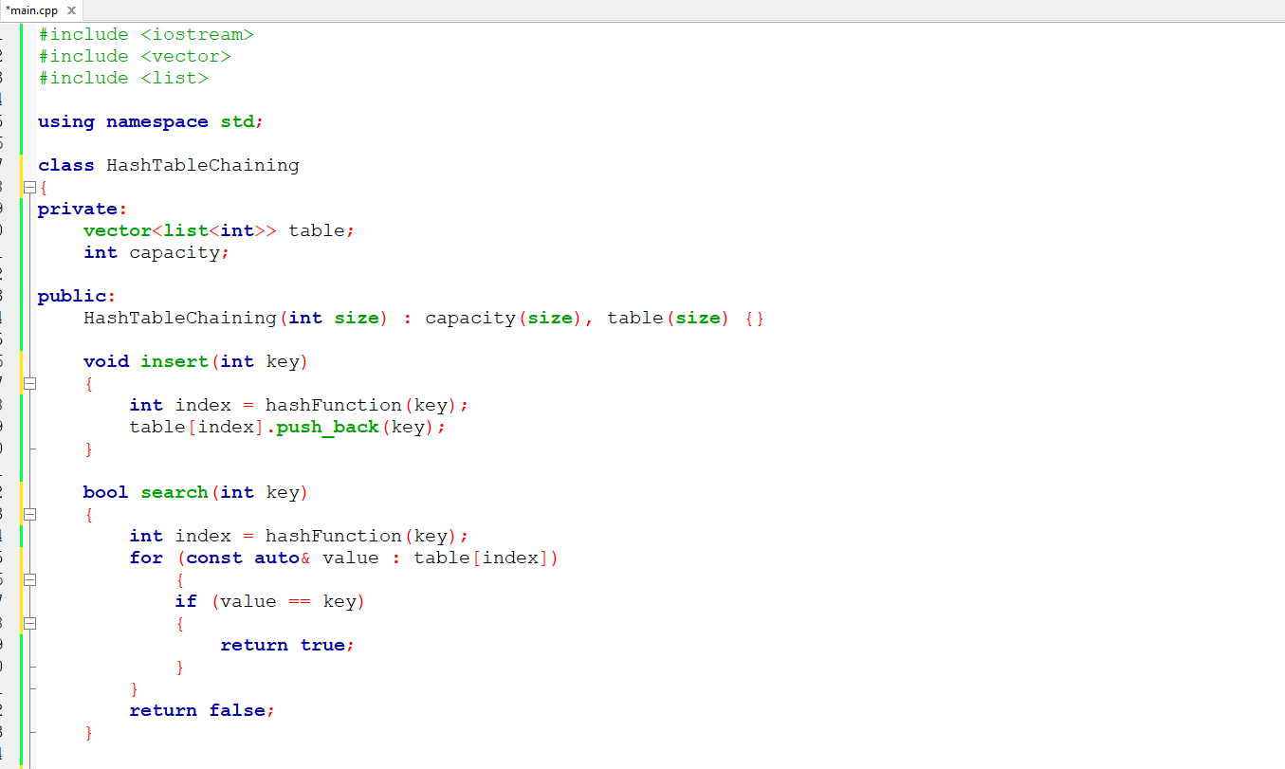
Chaining

Slide 10
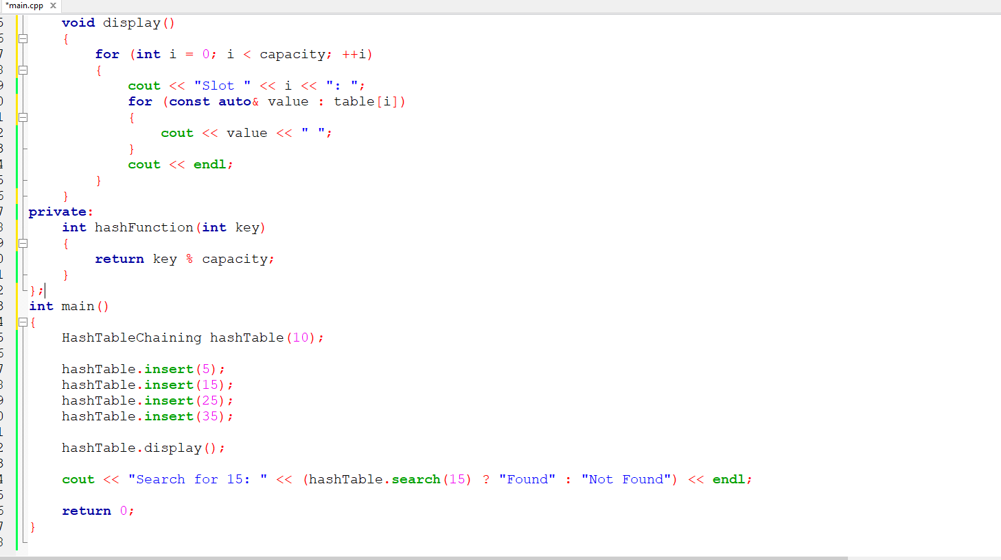
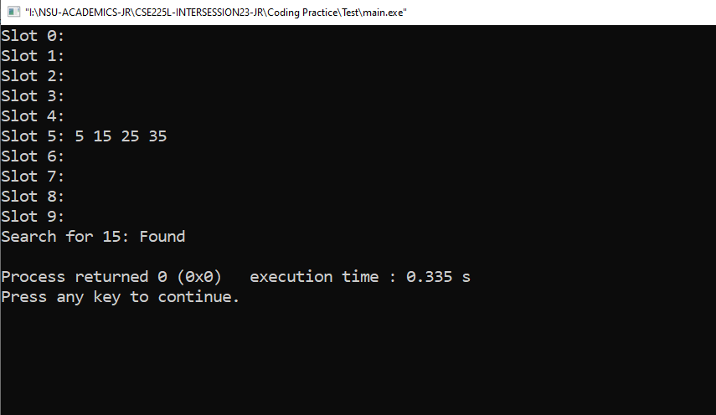
Chaining

Slide 11
Best Scenarios Suited
Open Addressing:
Memory efficiency is crucial, and the number of elements is relatively stable.
Linear probing may be suitable for simple implementations.
Chaining:
Collisions are likely, and the number of elements can vary significantly.
Simple insertion and retrieval are more critical than memory efficiency.

Slide 12
Real-World Applications
Database Indexing
Caching Mechanisms
Symbol Tables in Compilers
Network Routing Tables
Password Storage
Distributed Systems

Slide 13
Blockchain
Distributed and decentralized ledger.
Consists of a chain of blocks, where each block contains a list of transactions.
Each block is linked to its predecessor using cryptographic hashes, forming an immutable chain.

Slide 14
Characteristics
Decentralization
Security
Consensus
Smart Contracts

Slide 15
Problems Addressed
Security
Trustless Transactions
Transparency

Slide 16
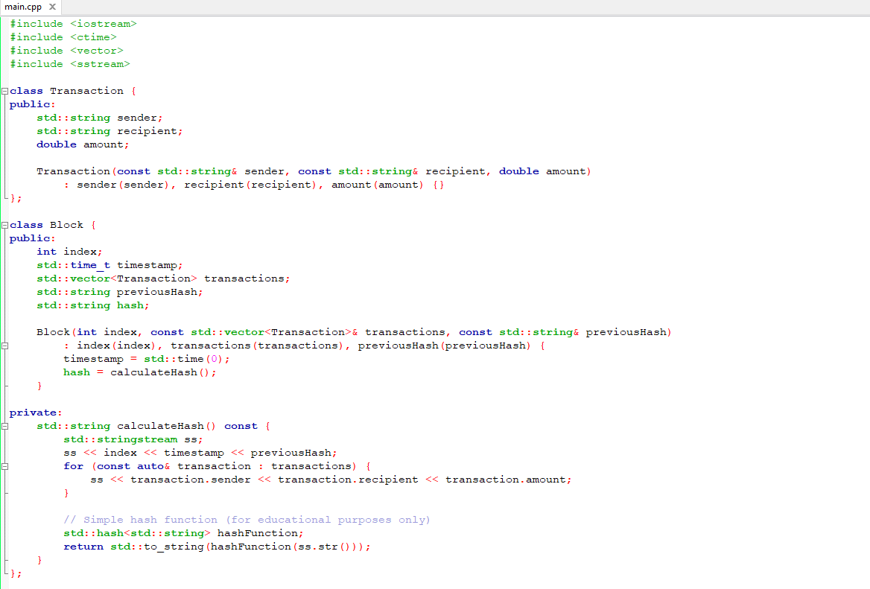
Implementation

Slide 17
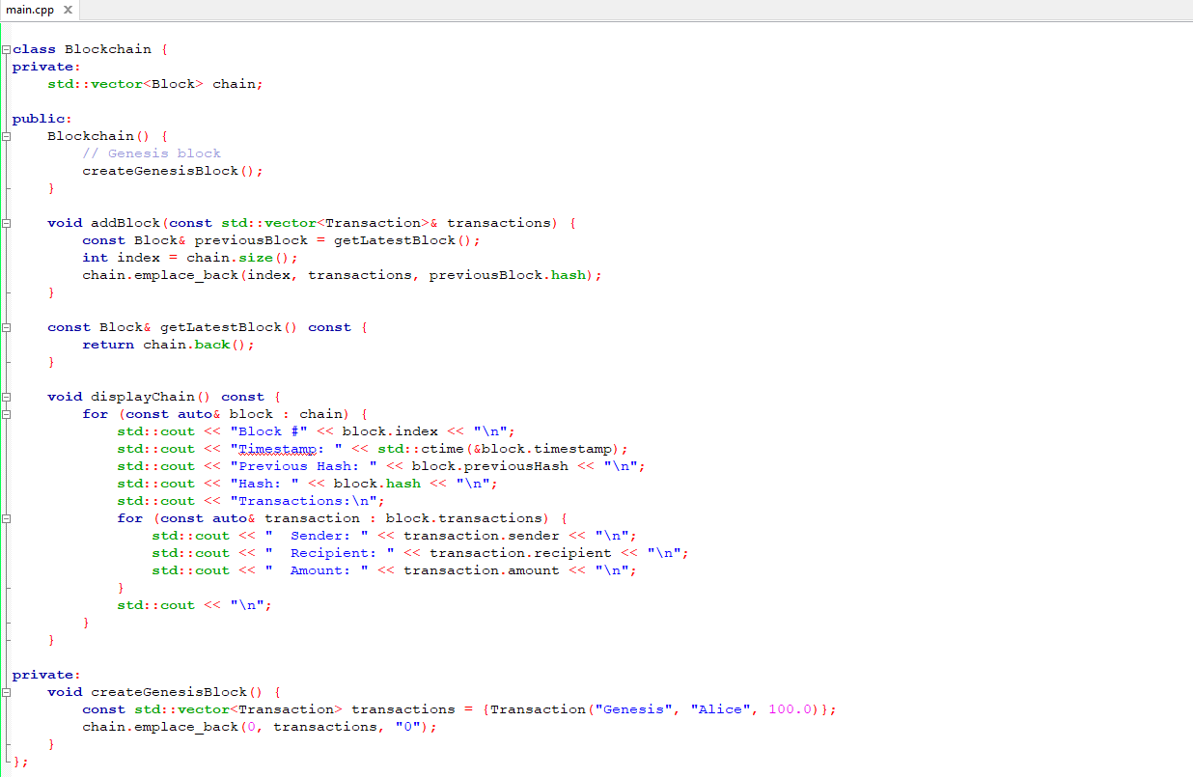
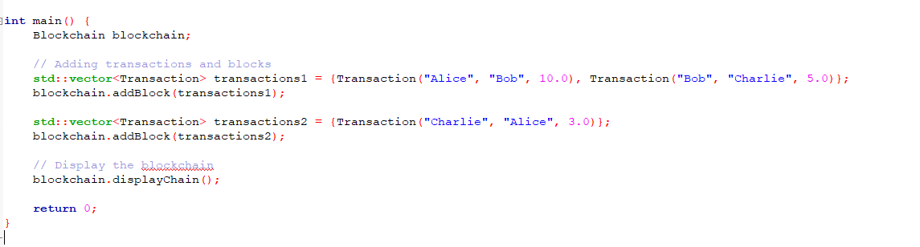
Implementation

Slide 18
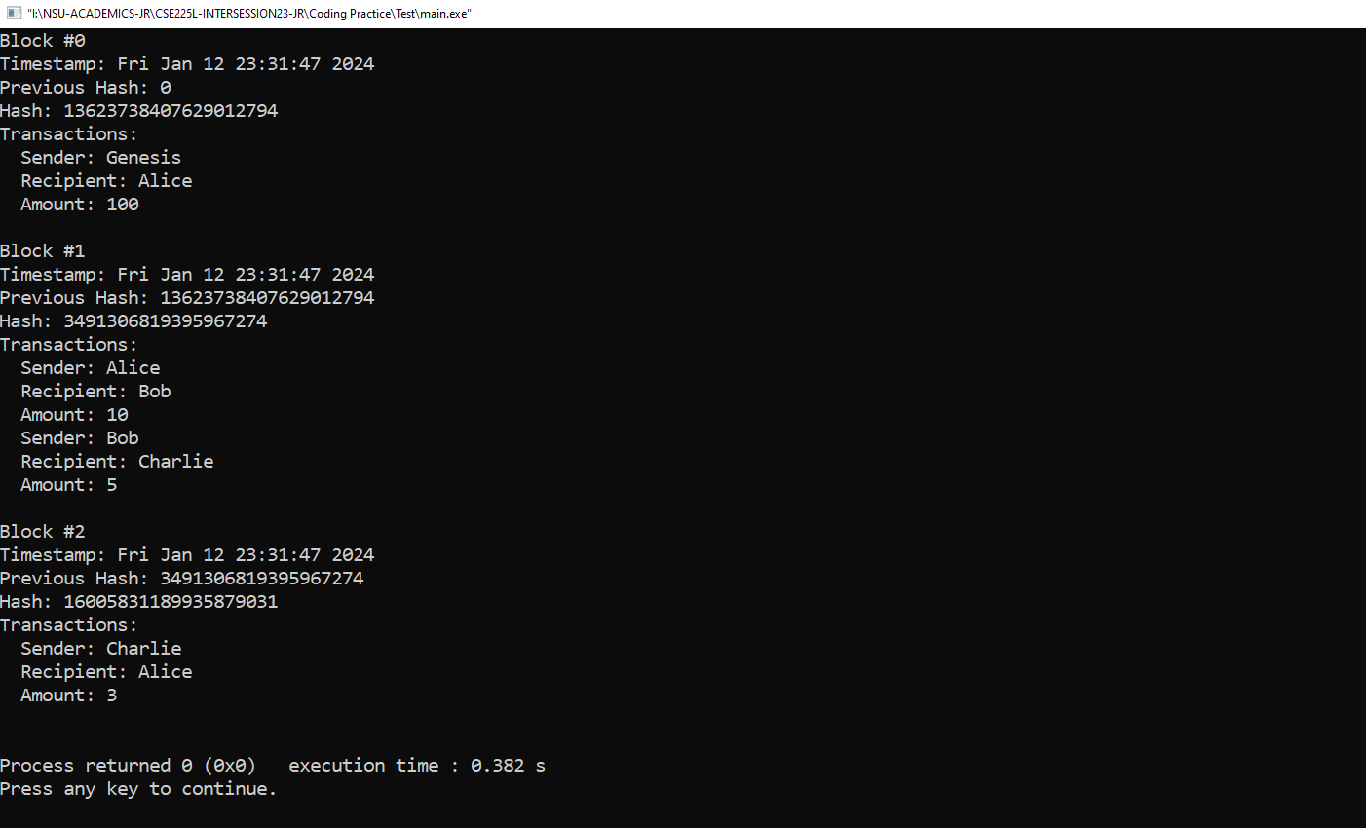
Implementation

Slide 19
Implementation Analysis
Public Blockchain:
Advantages: Decentralization, Security, Transparency.
Pitfalls: Scalability, Energy Consumption, Privacy Concerns.
Private Blockchain:
Advantages: Performance, Control, Privacy. Pitfalls: Centralization, Trust, Potential Cost.

Slide 20
Implementation Analysis
Consortium Blockchain:
Advantages: Shared Control, Enhanced Security, Collaboration.
Pitfalls: Complexity, Governance Challenges, Limited Decentralization.

Slide 21
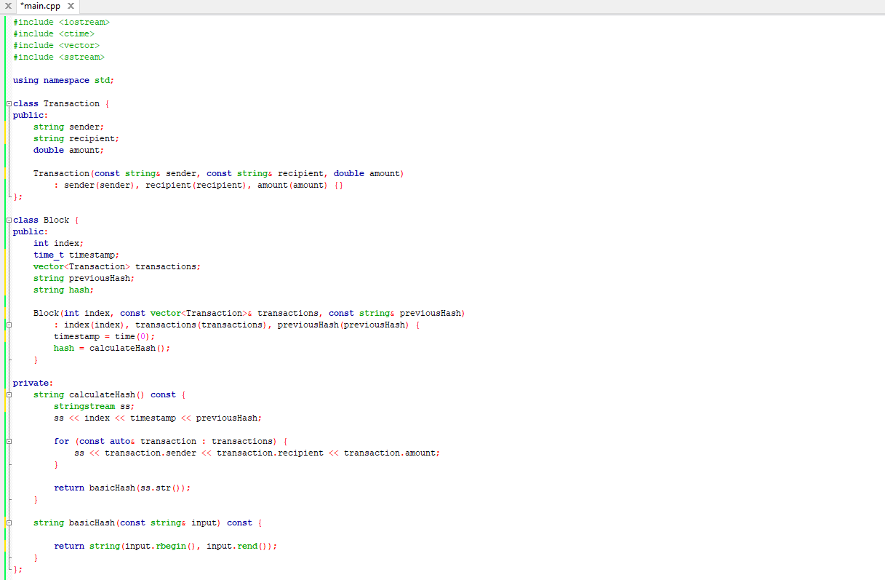
Public Blockchain

Slide 22
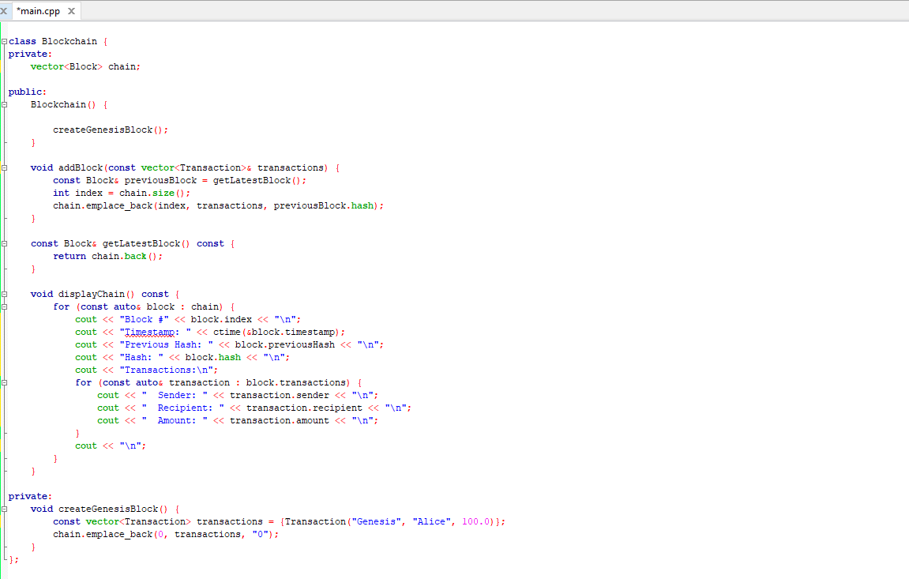
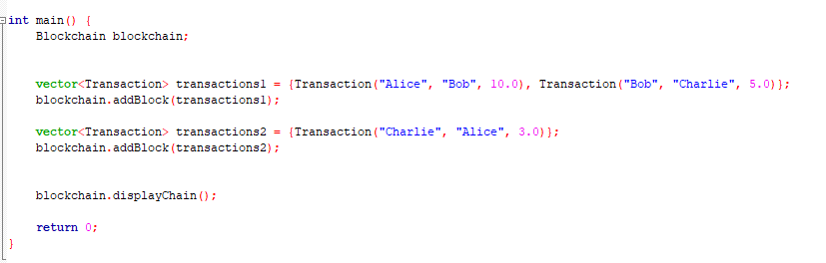
Public Blockchain

Slide 23
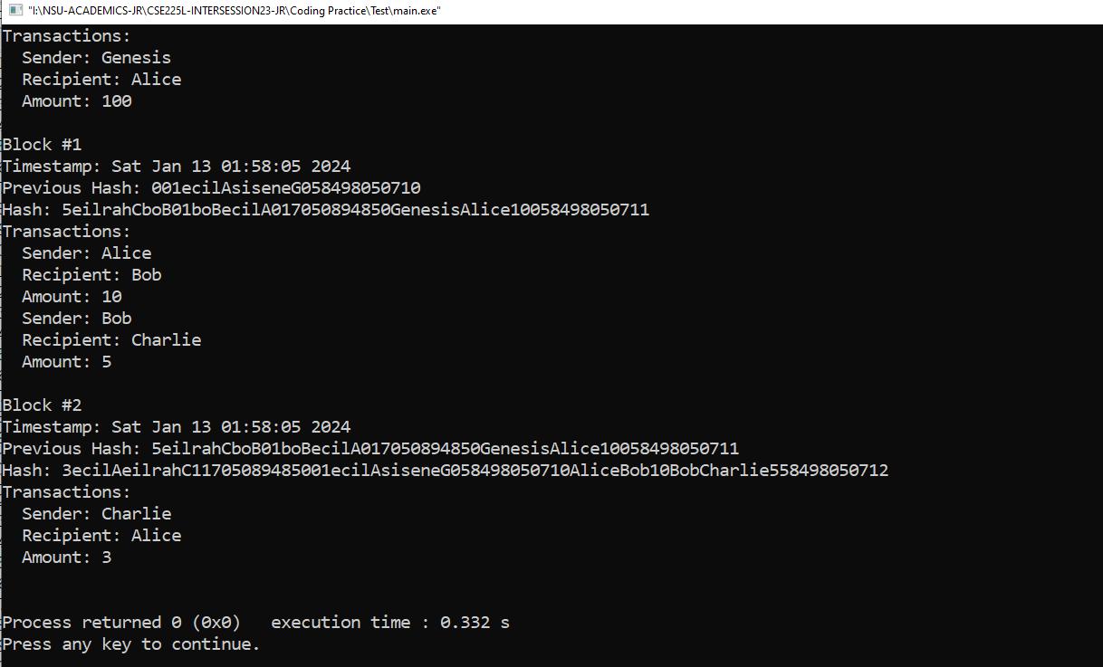
Public Blockchain

Slide 24
Best Scenarios Suited
Public Blockchain:
Decentralization, transparency, and security are paramount, such as cryptocurrencies. Example: Bitcoin.
Private Blockchain:
Enterprise applications where performance, privacy, and control are crucial, such as supply chain management.
Consortium Blockchain:
Best for situations where collaboration among multiple trusted entities is necessary, such as in the financial industry.

Slide 25
Real-World Applications
Finance: Cryptocurrencies, Smart Contracts
Supply Chain: Traceability, Reducing Fraud
Healthcare: Secure Health Records, Drug Traceability
Voting Systems: Transparent Elections
Identity Management: Decentralized Identity

Slide 26
Thank You

